Slide 1

THE PHOENIX
MART

Slide 2
TEAM MEMBERS
Arju Adhikari
MD Aashif Ansari
Coordinator
Plant
Sajil Maharjan
Nimisha Raut
Team Worker
Specialist

Slide 3
01 Project Initiation
Project Charter
Meeting Minutes
02 Project Planning
Skills Audit
Project Management (MS Project)
Communication Tools Used
03 Project Execution
Database Design
Use Case Diagram
Logo Design
Wireframe
Requirement Catalogue
Product Development
Table
Of
Content

Slide 4
PROJECT INITIATION
Project Charter
Meeting Minutes

Slide 5



Project Charter
Roles
and
Responsibilities
Version
Control
Project
Scope
Project
Justification
Project
Assumption

Slide 6

MEETING MINUTES
SCHEDULE
LOCATION
AGENDA

Slide 7
PROJECT PLANNING
Skill Audit
Ms Project
Communication Tools Used

Slide 8
SKILL AUDIT
HTML & CSS
Oracle
Frontend
Backend
JavaScript
PHP
.
.

Slide 9





MS PROJECT
Task Sheet
GANTT CHART
Timeline
CALENDER
RESOURCE SHEET

Slide 10
COMMUNICATION TOOL
DISCORD
Github
Gmail

Slide 11
PROJECT EXECUTION
Use Case Diagram
Logo Design
Wireframe
Database
Requirement Catalogue
Product Development

Slide 12
Customer Use case

Slide 13
Customer Use case

Slide 14
Customer Use case

Slide 15
Customer Use case

Slide 17
Trader Use case

Slide 18
Trader Use case

Slide 19
Trader Use case

Slide 20
Trader Use case

Slide 21
Trader Use case

Slide 23
Admin Use case

Slide 24
Admin Use case

Slide 25
Admin Use case

Slide 26
Admin Use case

Slide 27
Admin Use case

Slide 28
Admin Use case

Slide 31



LOGO DESIGN
Logo - Black
Logo -White
Logo -Icon

Slide 32
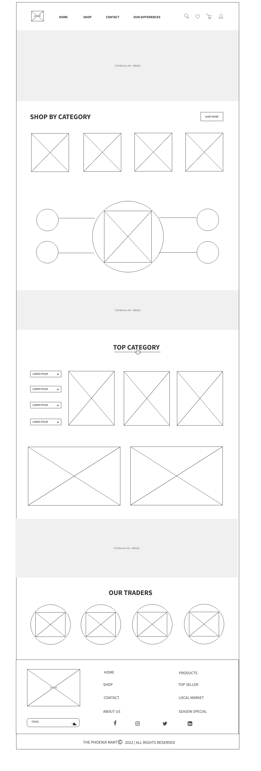
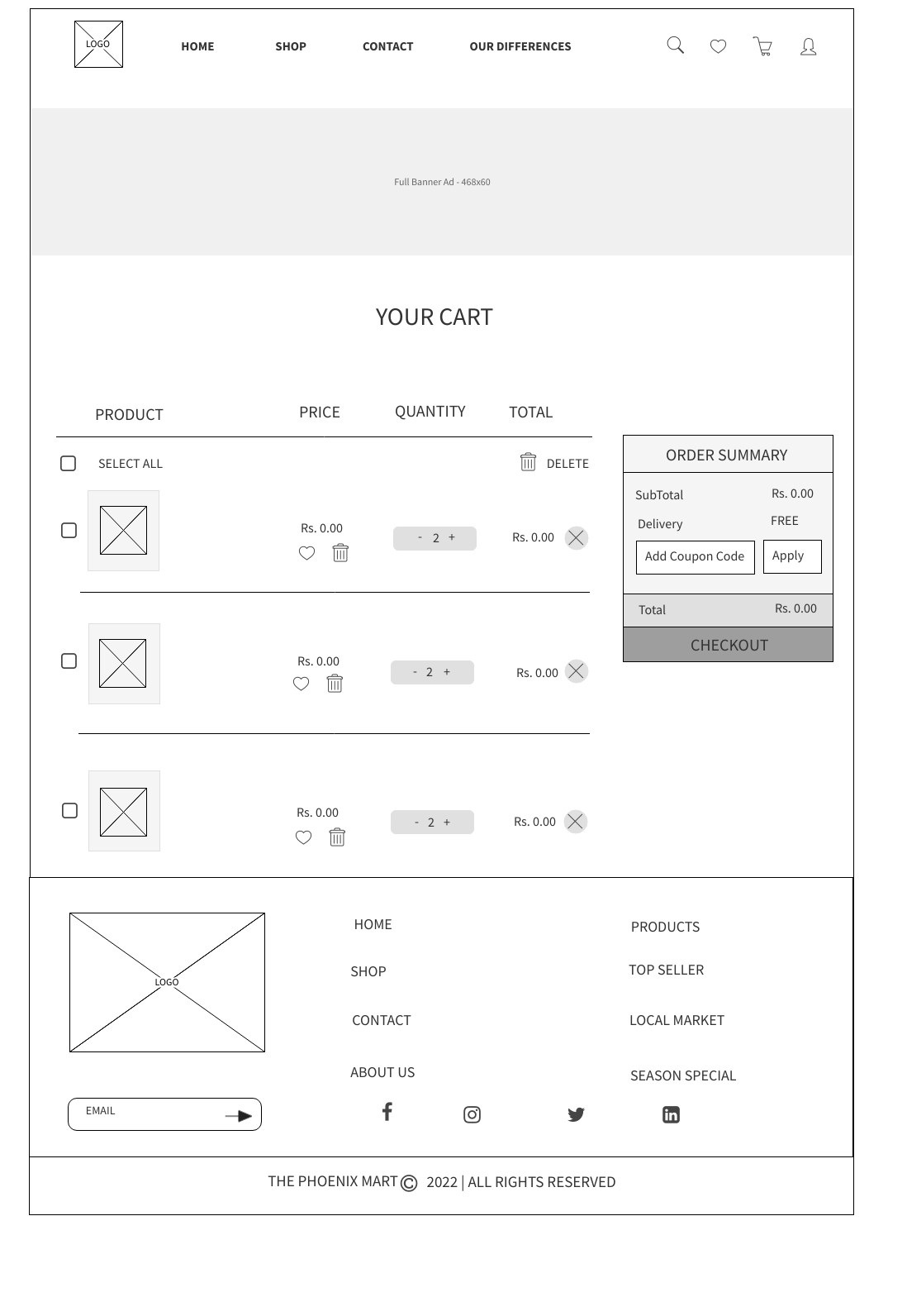
WIREFRAME DESIGN
Home Page
Cart Page

Slide 33
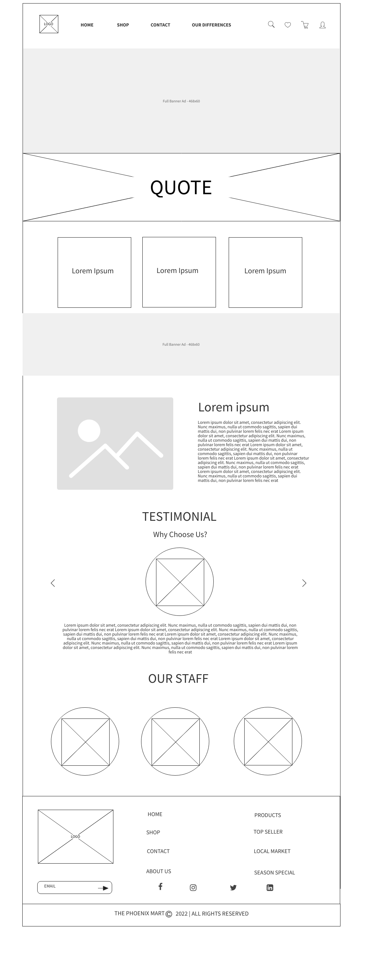
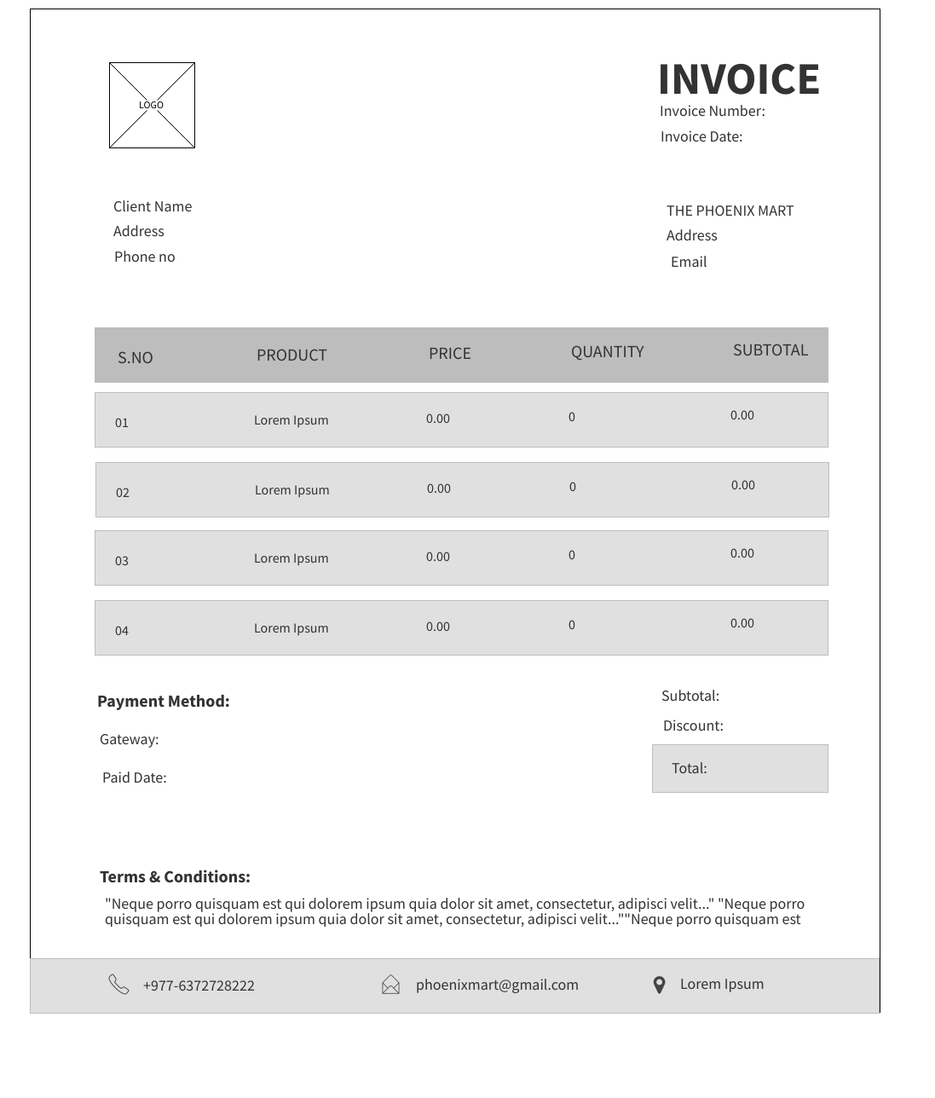
WIREFRAME DESIGN
About Us Page
Invoice

Slide 34
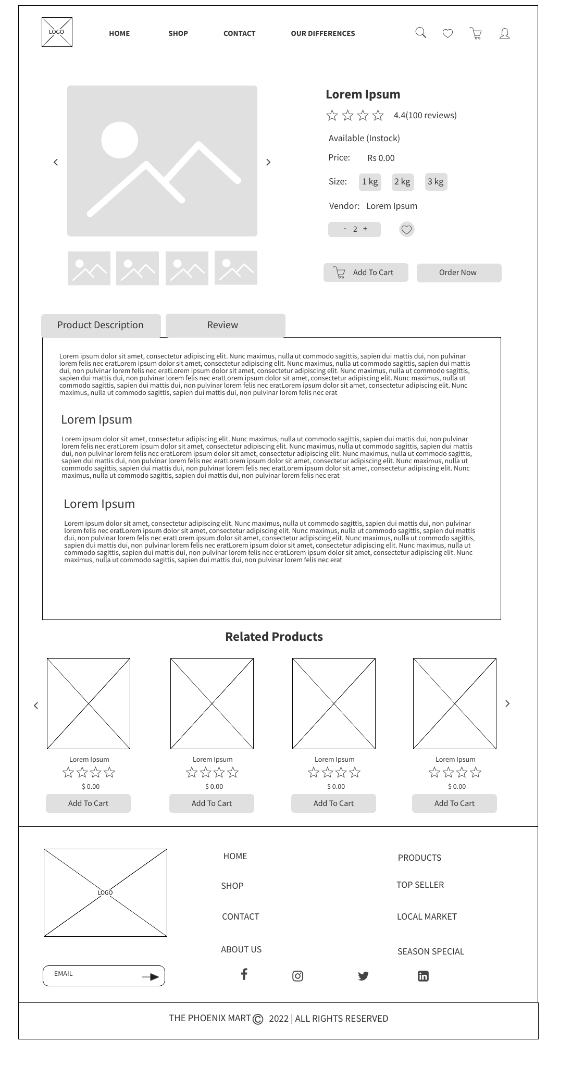
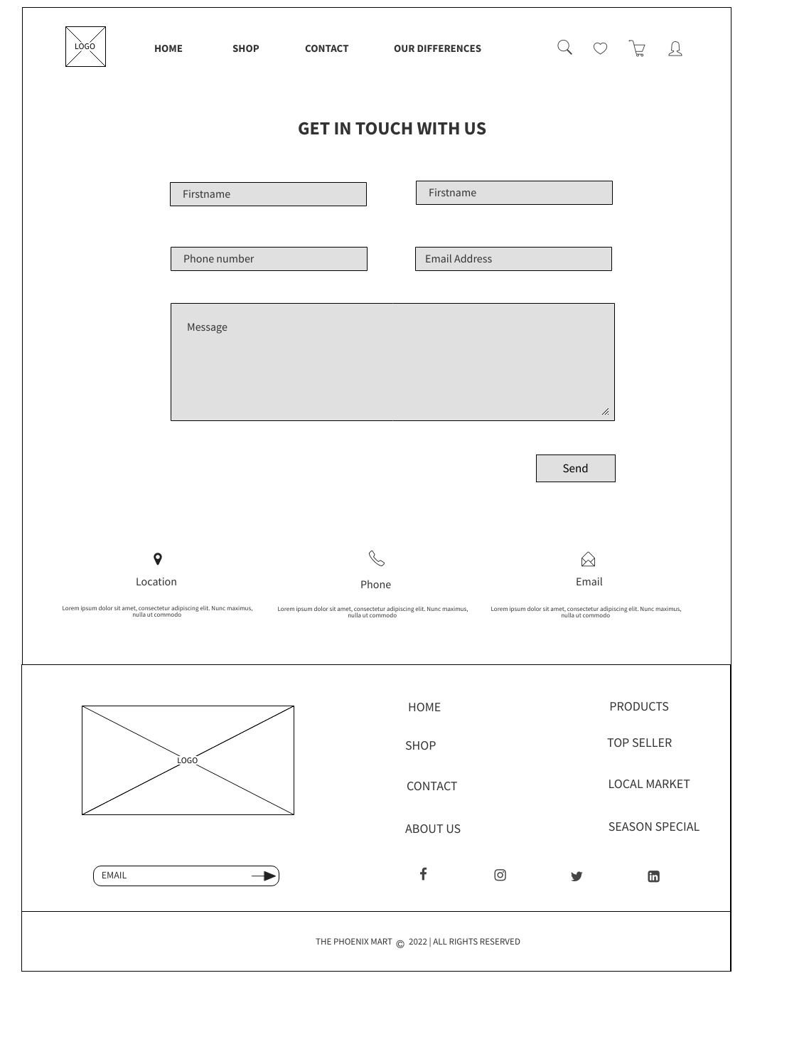
WIREFRAME DESIGN
Product Detail Page
Contact Page

Slide 35
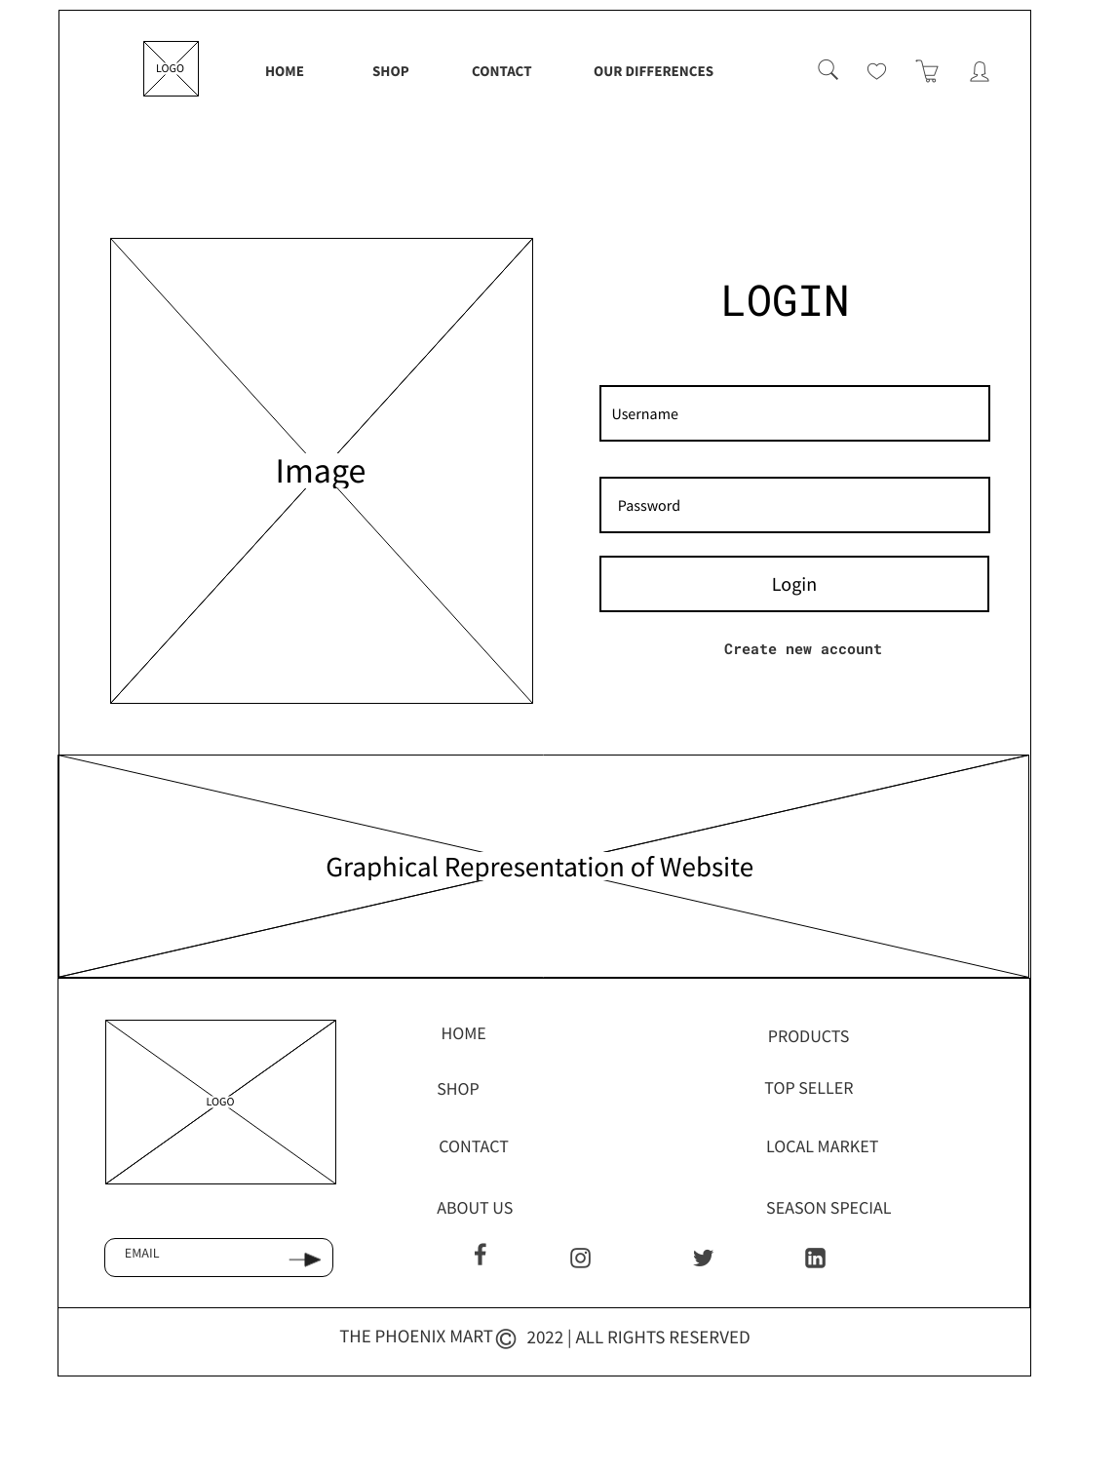
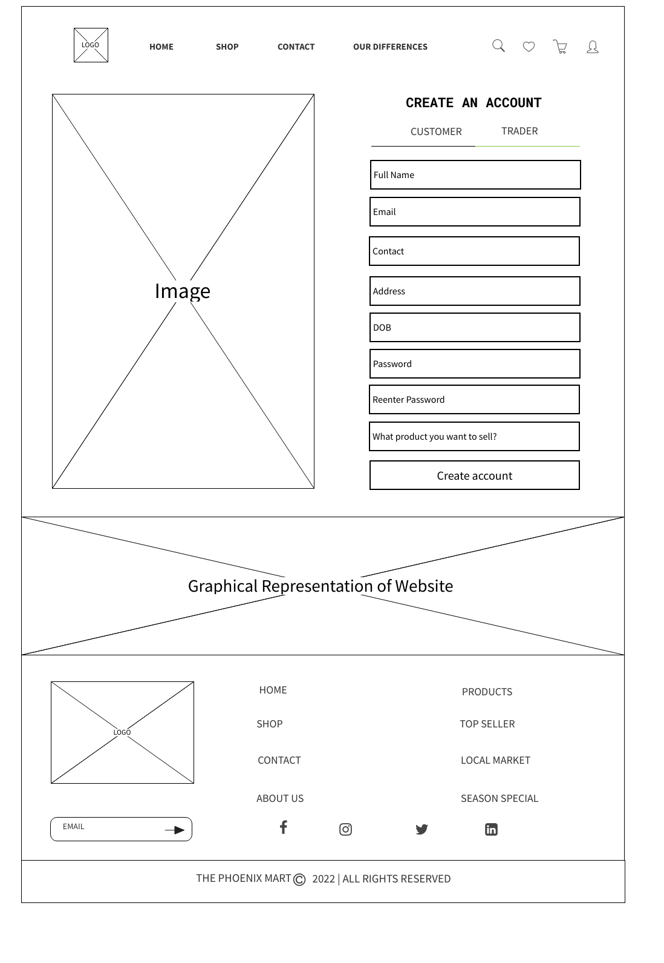
WIREFRAME DESIGN
Login Page
Signup Page

Slide 36
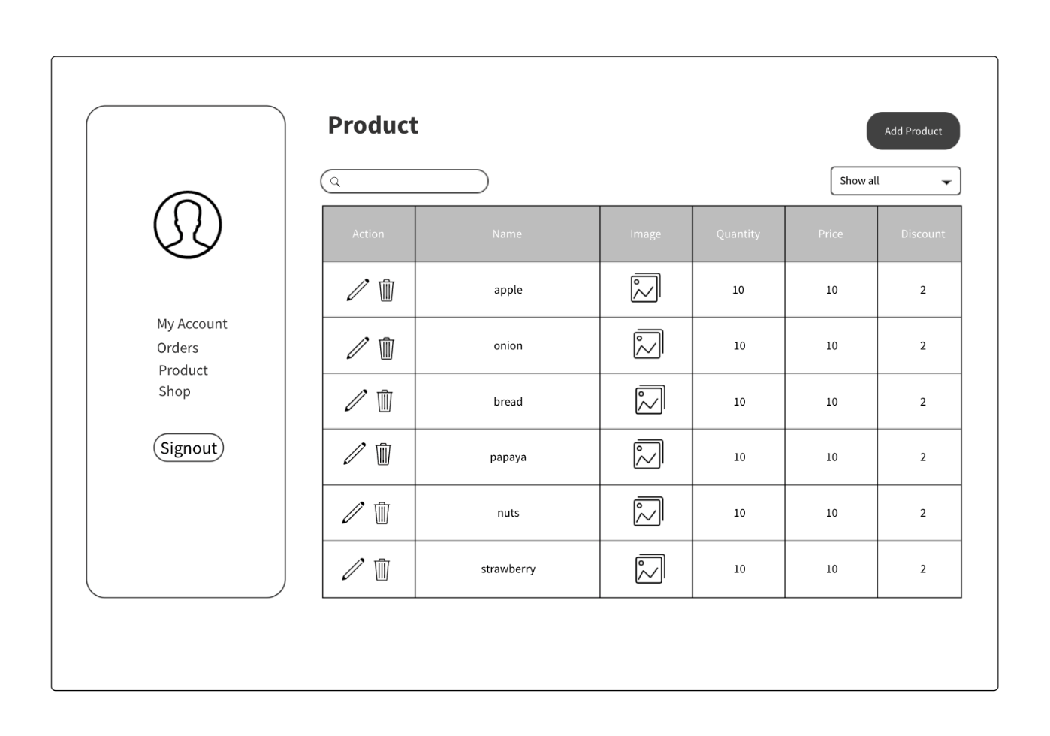
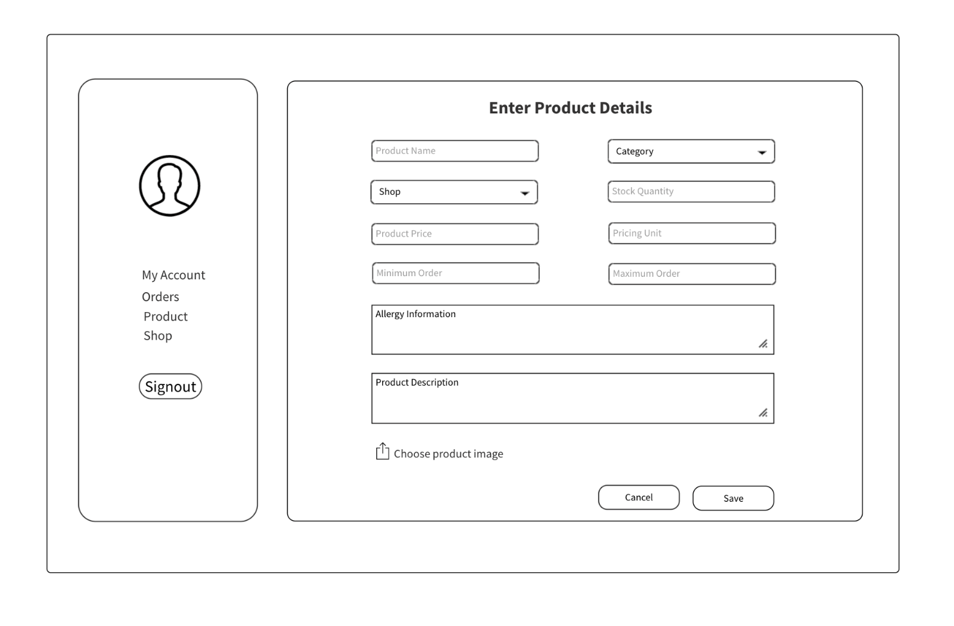
WIREFRAME DESIGN
Add Product Page
Product Page

Slide 37
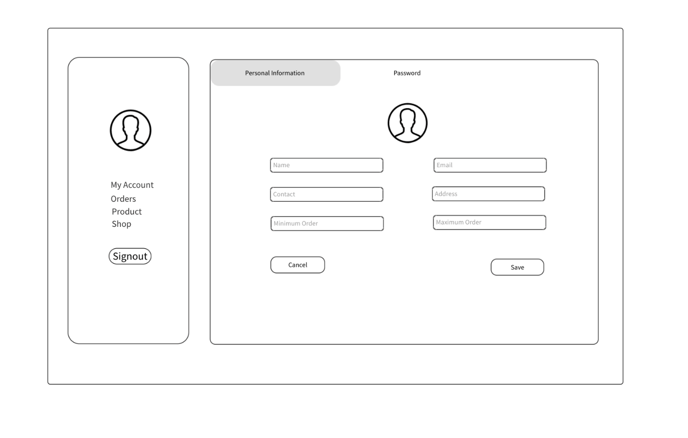
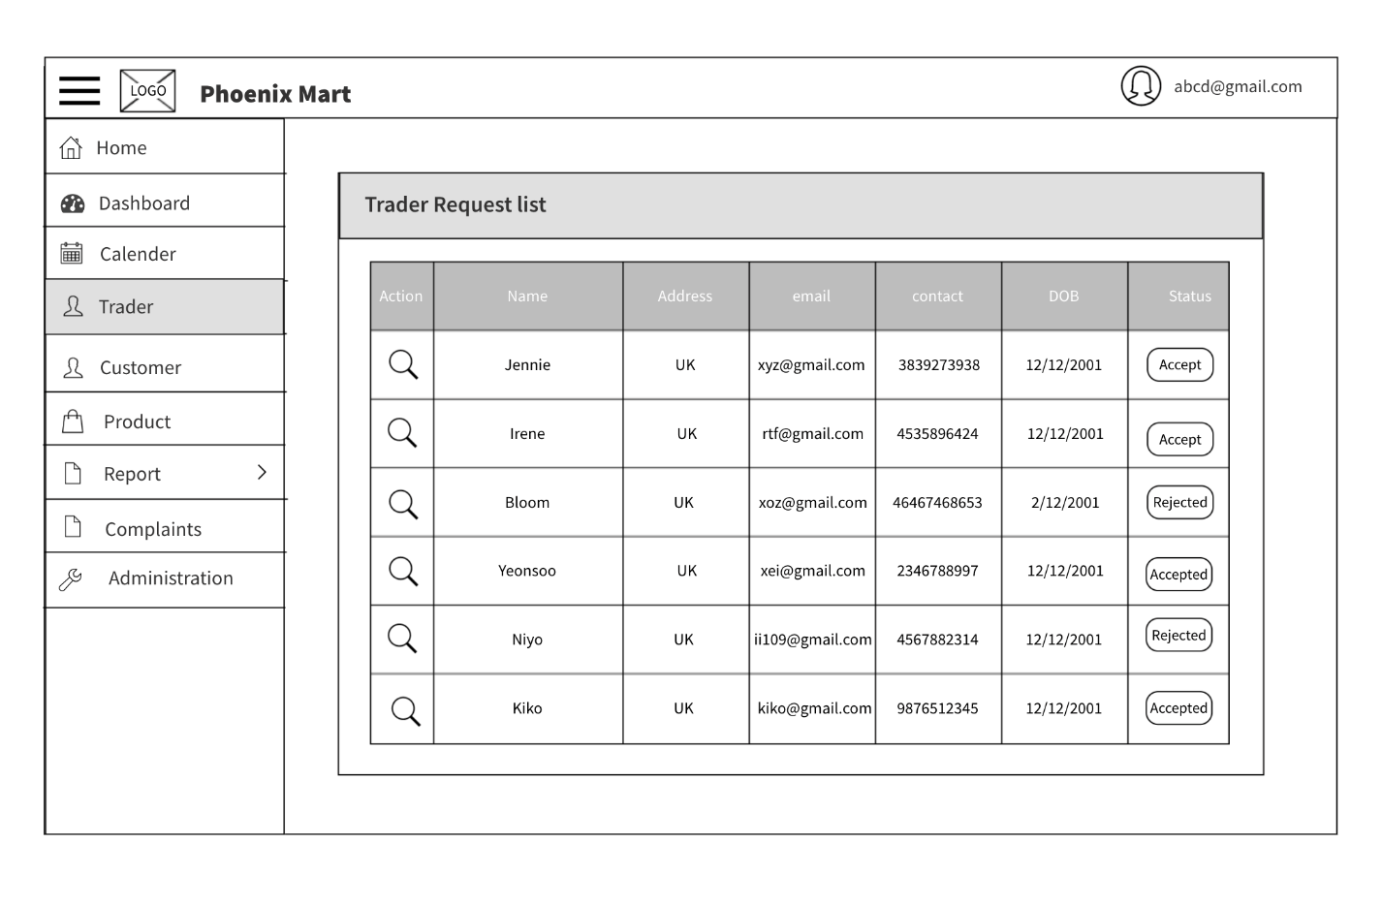
WIREFRAME DESIGN
Trader Profile Page
Add Trader Page

Slide 38
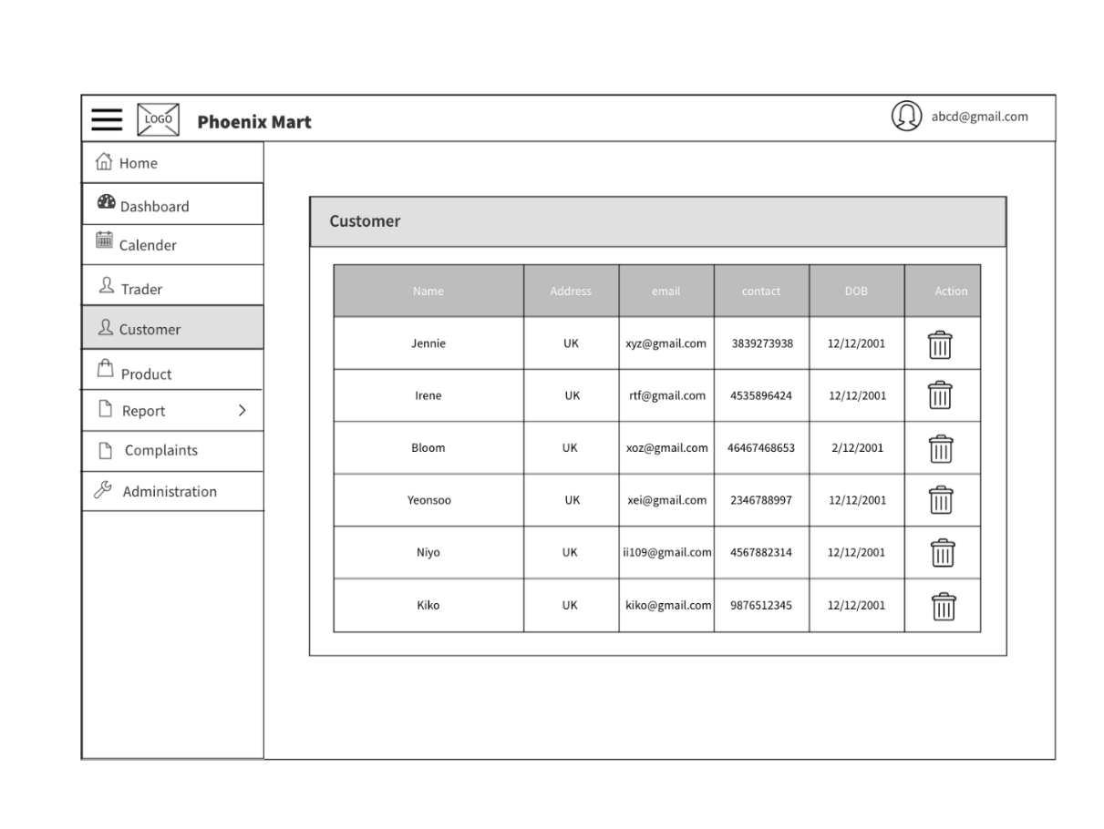
WIREFRAME DESIGN
Add Trader Page
Customer Detail Page

Slide 39
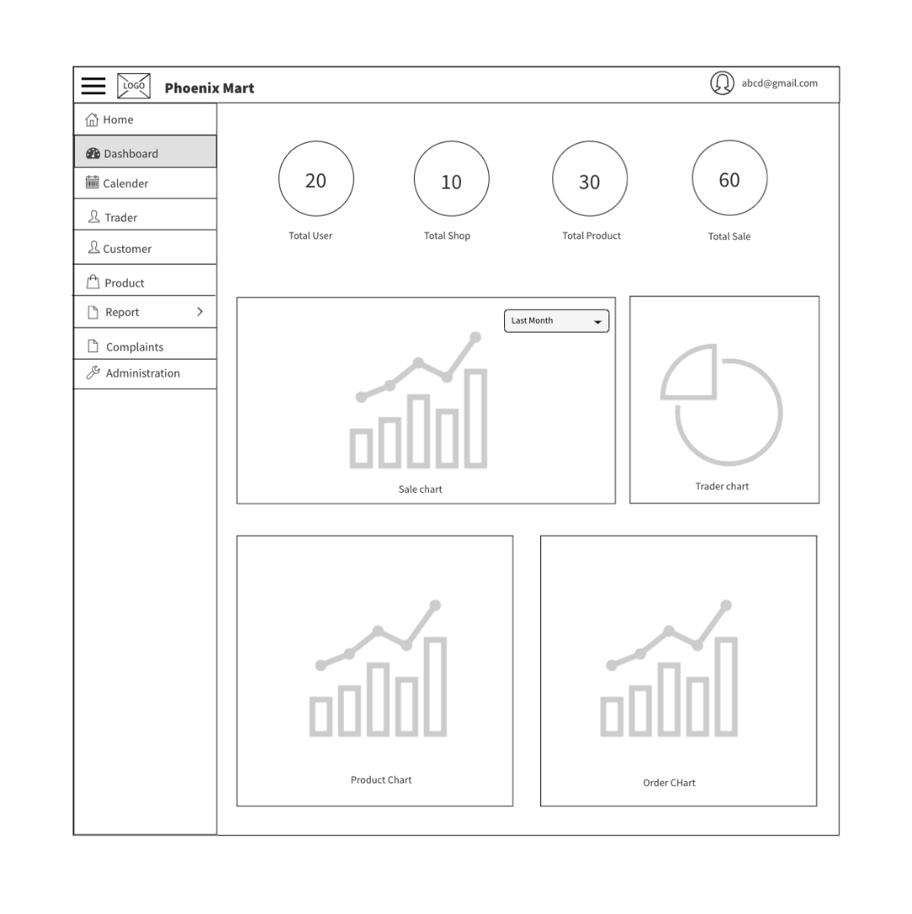
WIREFRAME DESIGN
Admin Dashboard

Slide 40
Entity

Slide 41
EERD

Slide 43
ERD

Slide 45
De-composite

Slide 46
De-composite

Slide 48


REQUIREMENT CATALOGUE
Non-Functional Requirement
Functional Requirement

Slide 49



MoSCoW
Must
Should
Could

Slide 50
Product
All products need details
Interface to navigate products.
Interface to add products in cart and wish list.
Reviewing and rating of products.

Slide 51
Customer
Registration form for new user.
Login form.
View and update profile.
Interface to view product.
Access to cart.
Interface to place order and view order details.

Slide 52
Trader
Registration form for new user.
Login form.
View and update profile.
Shop and product management.
Access to dashboard and report.

Slide 53
Admin
Login form in apex oracle.
Manage trader and user.
Reports.
Payment.

Slide 54
Non- Functional
Responsive.
Heritage reflection.
Password encryption.
Audit Table.

Slide 55
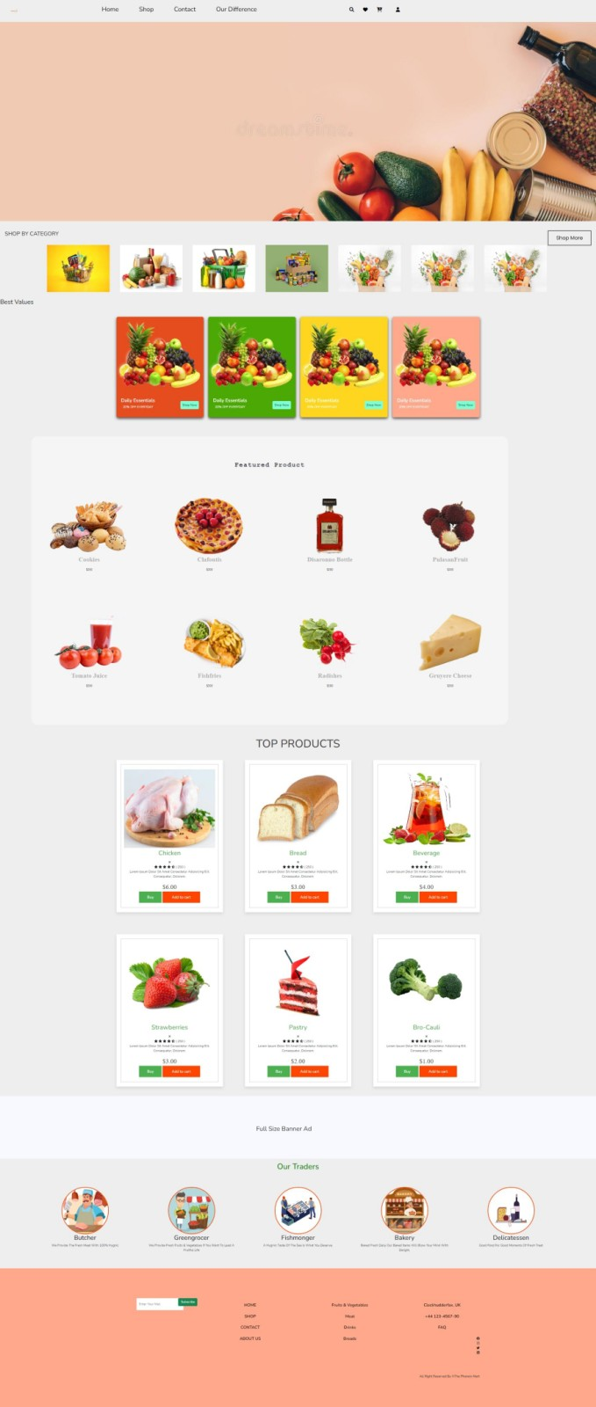

PRODUCT DEVELOPMENT
Homepage(Under Construction)
About Us (Under Construction)

Slide 56
THANKYOU

